Slide 1
"Unit 12: "For Live Session"
Chad Madding

Slide 2

On five to six PowerPoint slides, address the question of interest.
The data set (LA_Cmort_Study.csv) is a portion of the data taken from a study (Shumway 1988) on the possible effects of pollution and temperature on weekly cardiac mortality (heart attacks) in Los Angeles County.
Your goal is to utilize all given information to provide the most useful forecasts for the next 20 weeks of cardiac mortality.
You should include plots, tables, and charts to help make your analysis and inferences clear to your peers.

Slide 3
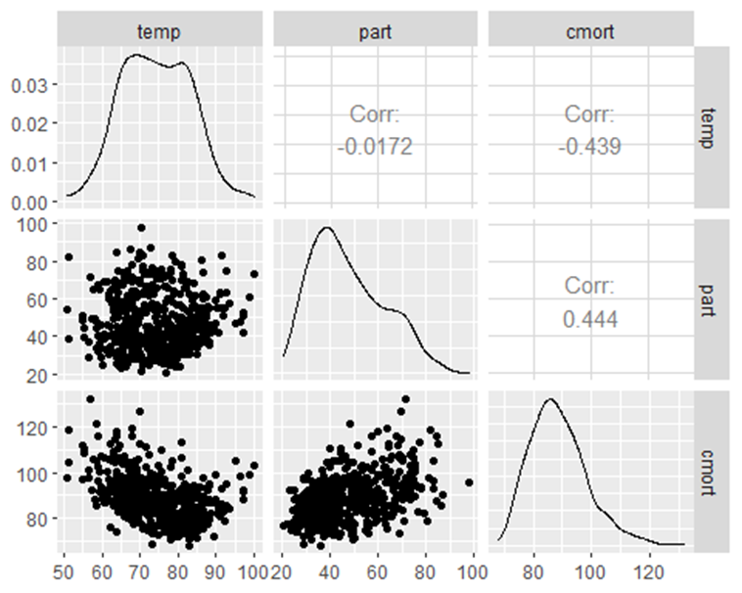
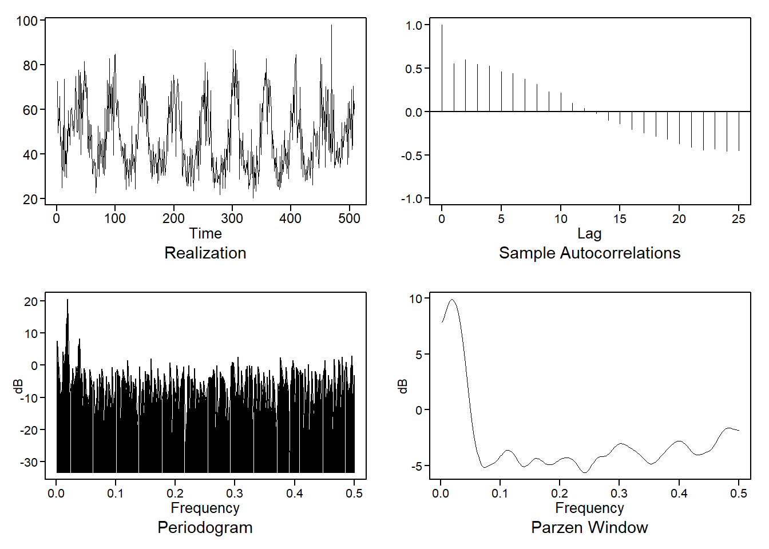
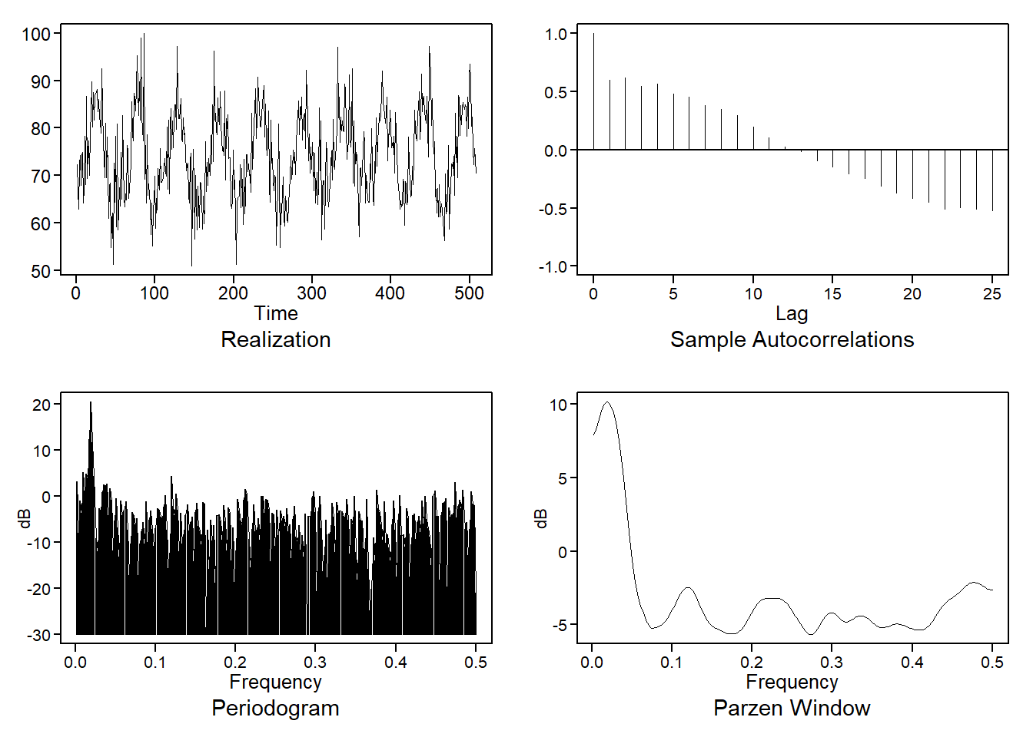
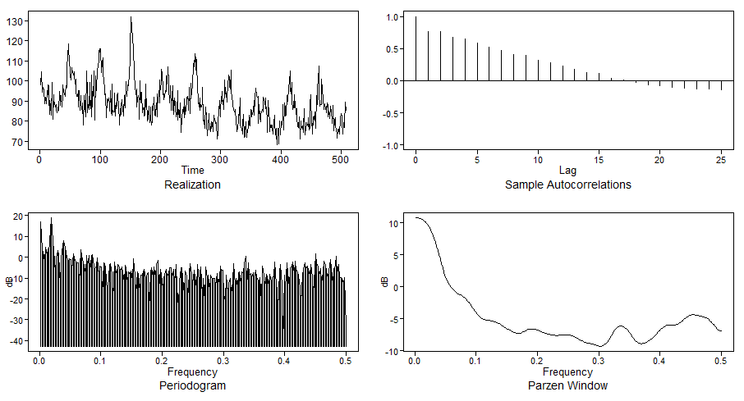
Visualization
I wanted to see if there are any visible correlations. There looks to be a slight positive relationship between Particles and Cardiac Mortality. There may, even be a negative correlation between Temperature and Cardiac Mortality.
Partial Data Peek near .0192/1=52.08 (annual)
Temperature Data Peek near .0192/1=52.08 (annual)
Cardiac Mortality Data

Slide 4
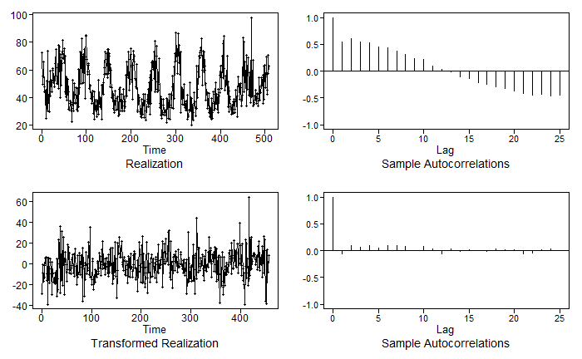
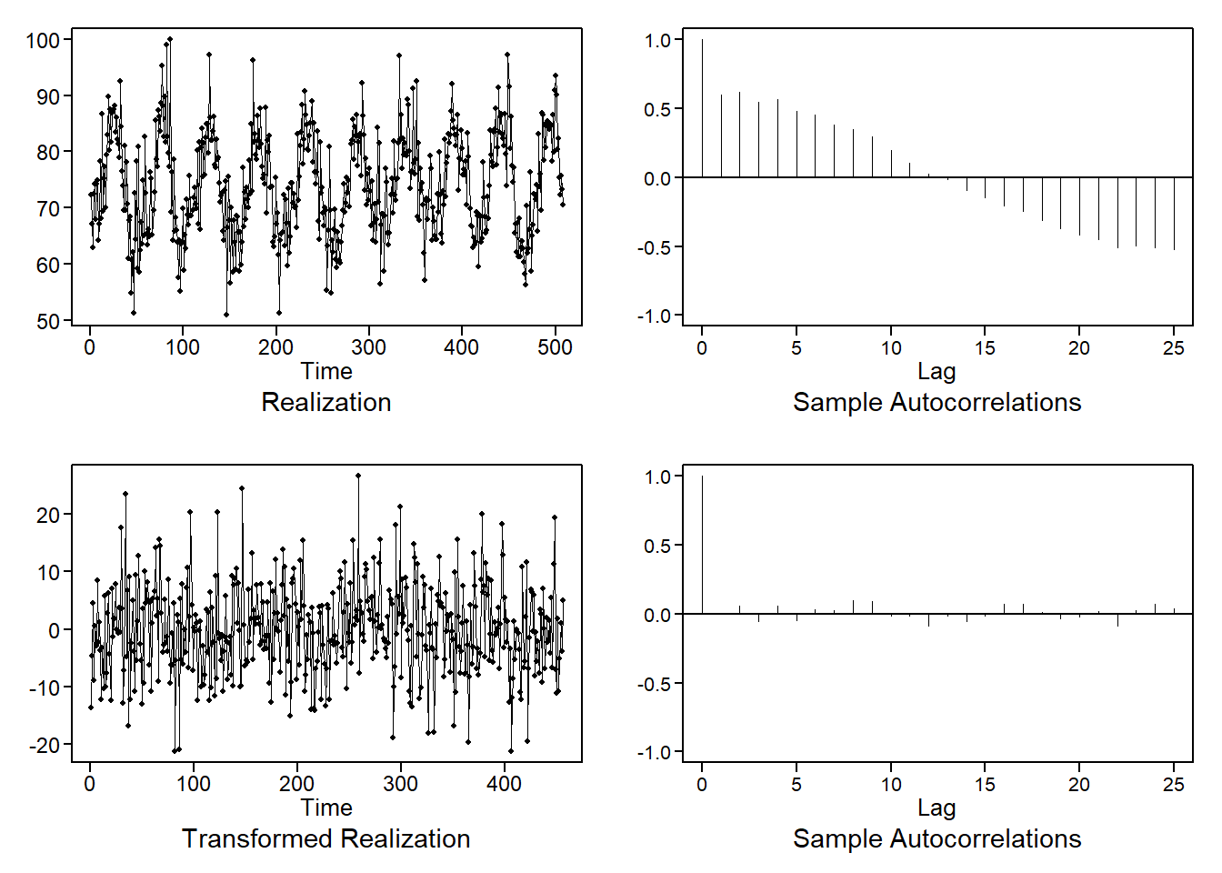
Looking at cardiac mortality (heart attacks) in Los Angeles County based on temperature, particles and week.
First we will forecast the Particles (part) and Temperature data separately.
Remove the seasonality of 52 from both with
CM_52p = artrans.wge(CM$part, c(rep(0,51),1))
CM_52t = artrans.wge(CM$temp, c(rep(0,51),1))
Using a visual test and the Ljung-Box Test – determined to be White Noise
Ljung-Box Test
ljung.wge(fit$residuals) # pval = .048
ljung.wge(fit$residuals, K = 48) # pval = .002
We now have 2 variables to use in the coming models:
predsPart = fore.aruma.wge(CM$part,s = 52, n.ahead = 20, limits = F)
predsTemp = fore.aruma.wge(CM$temp,s = 52, n.ahead = 20, limits = F)

Slide 5
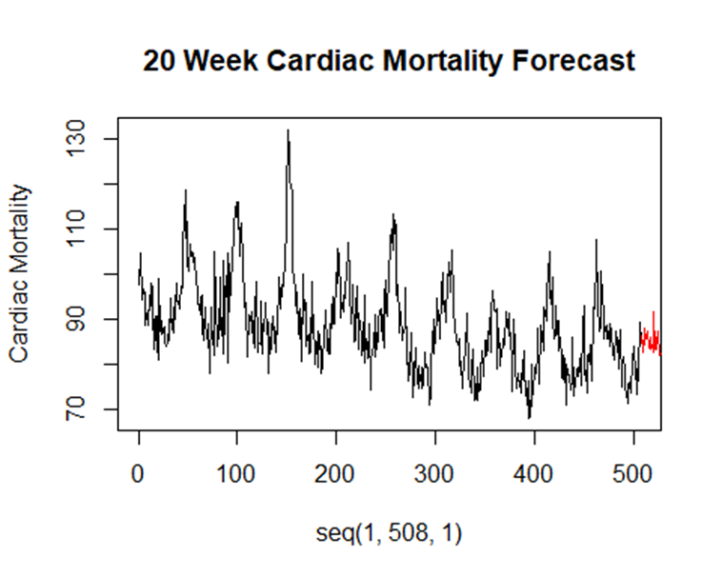
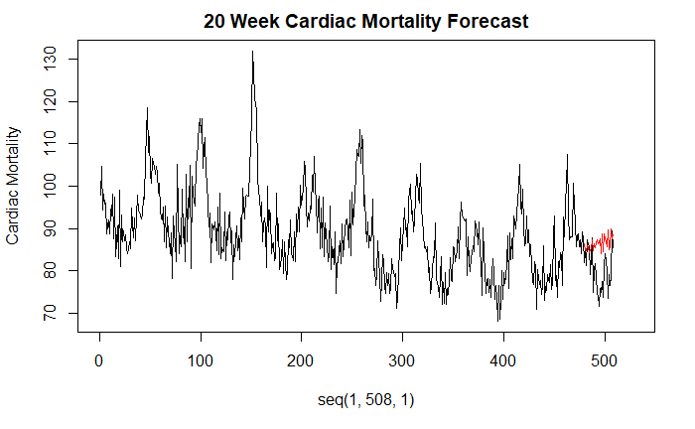
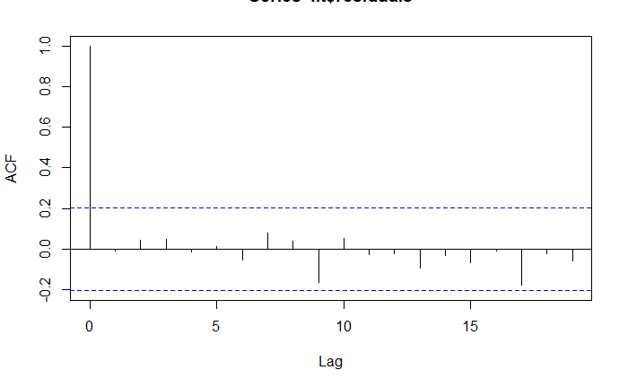
ARIMA1: MLR with Cor Errors (no lag, no seasonal categorical variable)
# Model cmort based on predicted part and temp using MLR with Cor Erros
ksfit = lm(cmort~temp+part+Week, data = CM)
phi = aic.wge(ksfit$residuals)
Fit an ARIMA with the phi from above (2). Binding the temperature, particle and week data with cbind.
fit = arima(CM$cmort,order = c(phi$p,0,0), seasonal = list(order = c(1,0,0), period = 52), xreg = cbind(CM$temp, CM$part, CM$Week))
Visually the acf is showing white noise. Now we need to check for whiteness of residuals with the Ljung-Box Test. Both 24 and 48 Ljung-Box rejected Ho.
Load the forecast Part and Temp data in a data frame. This will extend the week from 509 to 528 with **seq**.
```{r}
next20 = data.frame(temp = predsTemp$f, part = predsPart$f, Week = seq(509,528,1))
```
This will get the predictions
```{r}
#get predictions
predsCMort = predict(fit,newxreg = next20)
```
plot next 20 cmort wrt time
```{r}
plot(seq(1,508,1), CM$cmort, type = "l",xlim = c(0,508), ylab = "Cardiac Mortality", main = "20 Week Cardiac Mortality Forecast")
lines(seq(509,528,1), predsCMort$pred, type = "l", col = "red")
```
ASE_ARMA1
[1] 64.22125

Slide 6

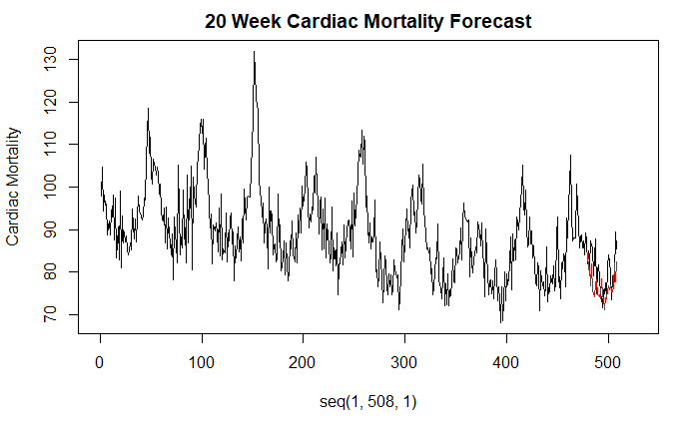
ARIMA2: Add a categorical variable for 52 week count
#This will add FWeek (52 week count) to the CM dataset
CM$FWeek = as.factor(CM$Week%%52)
ksfit = lm(cmort~temp+part+Week+FWeek, data = CM)
phi = aic.wge(ksfit$residuals)
fit = arima(CM$cmort,order = c(phi$p,0,0), xreg = cbind(CM$temp, CM$part, CM$Week, CM$FWeek))
Check for whiteness of residuals with a visual test and the Ljung-Box Test
acf(fit$residuals)
ljung.wge(fit$residuals) # pval = .066
ljung.wge(fit$residuals, K = 48) # pval = .0058
load the forecasted Part and Temp in a data frame
next20 = data.frame(temp = predsTemp$f, part = predsPart$f, Week = seq(509,528,1), FWeek = as.factor(seq(509,528,1)%%52))
get predictions - predict residuals
plotts.sample.wge(ksfit$residuals)
phi = aic.wge(ksfit$residuals)
resids = fore.arma.wge(ksfit$residuals,phi = phi$phi,n.ahead = 20, limits = F)
#predict trend manually
preds = predict(ksfit, newdata = next20)
predsFinal = preds + resids$f
Plot the next 20 cmort wrt time
plot(seq(1,508,1), CM$cmort, type = "l",xlim = c(0,528), ylab = "Cardiac Mortality", main = "20 Week Cardiac Mortality Forecast")
lines(seq(509,528,1), predsFinal, type = "l", col = "red")
length(predsFinal)
ASE_ARMA2 = mean((CM$cmort[479:508] - predsFinal)^2,na.rm = TRUE)
ASE = 32.45511

Slide 7
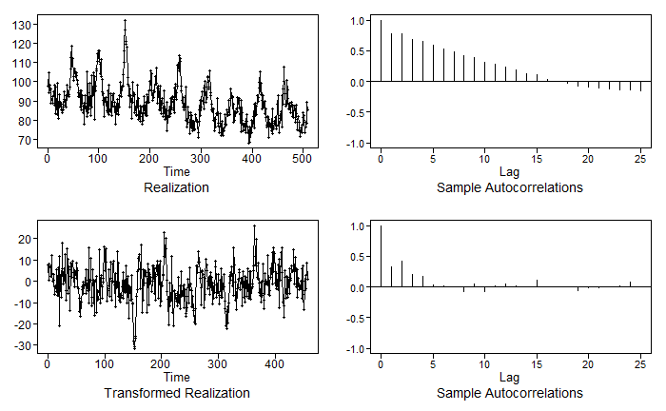
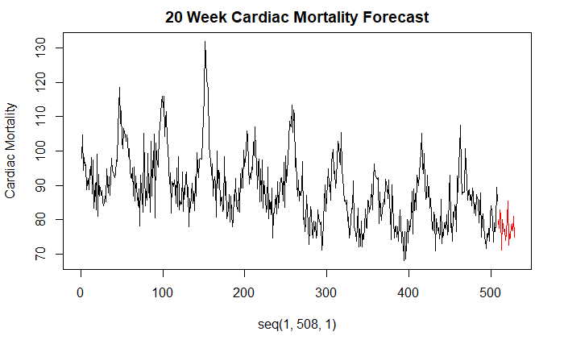
VAR Model to Forecasts Seasonally using differenced data
Difference all series to make them stationary.
```{r}
CM = read.csv("la_cmort_study.csv", header = TRUE)
CM_52 = artrans.wge(CM$cmort,c(rep(0,51),1))
Part_52 = artrans.wge(CM$part,c(rep(0,51),1))
Temp_52 = artrans.wge(CM$temp,c(rep(0,51),1))
#VARSelect on Differenced Data chooses 2
VARselect(cbind(CM_52, Part_52, Temp_52),lag.max = 10, type = "both")
#VAR with p = 2
CMortDiffVAR = VAR(cbind(CM_52, Part_52, Temp_52),type = "both",p = 2)
preds=predict(CMortDiffVAR,n.ahead=20)
#We have predicted differences .... calculate actual cardiac mortalities
startingPoints = CM$cmort[428:457]
CMortForcasts = preds$fcst$CM_52[,1:3] + startingPoints
#Plot
while (!is.null(dev.list())) dev.off()
plot(seq(1,508,1), CM$cmort, type = "l",xlim = c(0,528), ylab = "Cardiac Mortality", main = "20 Week Cardiac Mortality Forecast")
lines(seq(509,528,1), as.data.frame(CMortForcasts)$fcst, type = "l", col = "red")
ASE_VAR1 = mean((CM$cmort[489:508] - CMortForcasts[,1])^2)
ASE_VAR1
ASE=25.47226
Of the three models I used the VAR had the lowest ASE at 25.48.

Slide 8
On three to four Power Point slides, find the ASE for forecasts of the last five observations of the sales data set example for both the MLE model (using ARIMA) and the VAR model we fit.
We fit several models using the arima() function, you should pick the one you feel is the best model (maybe with the lowest AIC?).
Your slides should include each of the following:
Your code
Enough visual aids to describe how you calculated the ASE for each model
The ASE for each model
Which model you feel is better in that respect, and why.

Slide 9
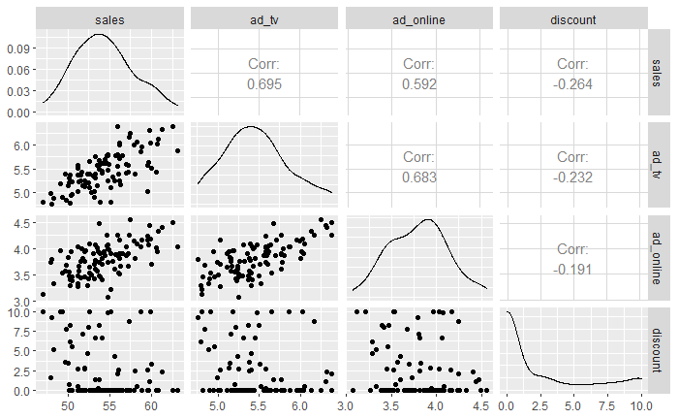
Modeling with the sales data set
Read in and visualize the sales data
```{r}
BSales = read.csv("businesssales.csv", header = TRUE)
## Visualaze The Data
head(BSales)
#Make a matrix of plots with the BSales data set.
ggpairs(BSales[2:5]) #matrix of scatter plots
```
## X sales ad_tv ad_online discount ## 1 1 52.61137 5.105617 3.646744 0.0000000 ## 2 2 50.46478 5.233105 3.381140 0.0000000 ## 3 3 50.15374 5.202212 3.550546 0.7571115 ## 4 4 49.68254 5.386699 3.570285 3.5303790 ## 5 5 50.44613 4.961060 3.460531 5.4983130 ## 6 6 51.72145 5.153207 3.801946 7.2211060
Looking at the above plot we can see that advertising in general (TV and Online) does seem to have a positive correlation with sales where discounts doe not seem to have any correlation at all.

Slide 10
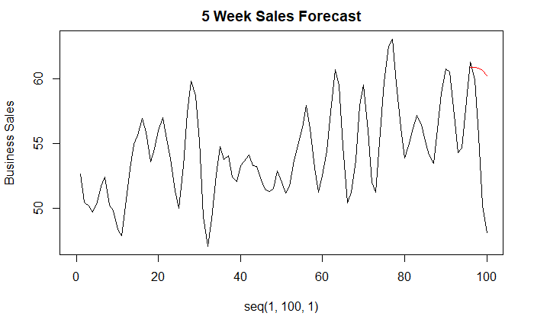
MLR Model
Looking at a model with all the data and no lag and no trend
ksfit=lm(sales~ad_tv+ad_online+discount, data = BSales)
aic.wge(ksfit$residuals,p=0:8, q=0) # AIC picks p=7
fit=arima(BSales$sales,order=c(7,0,0),xreg=BSales[,3:5])
fit
acf(fit$residuals)
ltest = ljung.wge(fit$resid)
ltest$pval
Reject [1] 0.6491731
ASE for model with no lag and no trend (last 5)
Cut off the last 5
BSales2 = BSales[1:95,]
ksfit=lm(sales~ad_tv+ad_online+discount, data = BSales2)
aic.wge(ksfit$residuals,p=0:8, q=0) # AIC picks p=7
Fit and Predict with BSales2
fit=arima(BSales2$sales,order=c(7,0,0),xreg=cbind(BSales2$ad_tv,BSales2$ad_online,BSales2$discount))
fit
preds = predict(fit, newxreg = cbind(BSales$ad_tv[96:100],BSales$ad_online[96:100],BSales$discount[96:100]))
Using sales from the original data and the predictions from BSales2 (95)
ASE1 = mean((BSales$sales[96:100] - preds$pred)^2)
ASE1
while (!is.null(dev.list())) dev.off()
plot(seq(1,100,1), BSales$sales[1:100], type = "l",xlim = c(0,100), ylab = "Business Sales", main = "5 Week Sales Forecast")
lines(seq(96,100,1), preds$pred, type = "l", col = "red")
ASE=57.11

Slide 11
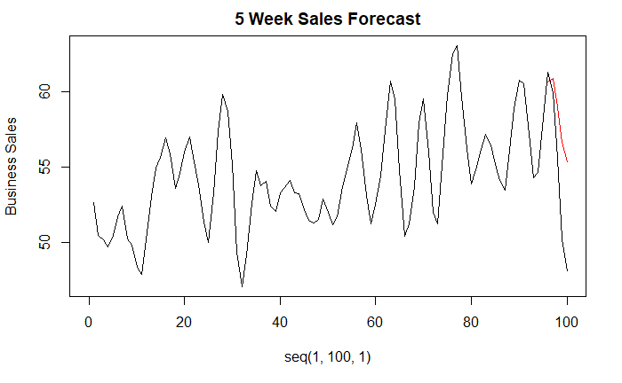
VAR Model
Modeling only the “ad” data with no lag and not using the discount data. Using the BSales2 (95) data to evaluate forecasting.
ASE = 21.44551
BSVar = VAR(cbind(BSales2$sales,BSales2$ad_tv,BSales2$ad_online), type = "both", lag.max = 10)
preds = predict(BSVar,n.ahead = 5)
ASE5 = mean((BSales$sales[96:100] - preds$fcst$y1[,1])^2)
ASE5
while (!is.null(dev.list())) dev.off()
plot(seq(1,100,1), BSales$sales[1:100], type = "l",xlim = c(0,100), ylab = "Business Sales", main = "5 Week Sales Forecast")
lines(seq(96,100,1), preds$fcst$y1[,1], type = "l", col = "red")
The VAR model performed better than the MLR. I feel that not having the discount in the model helped in getting a better ASE.

Slide 12
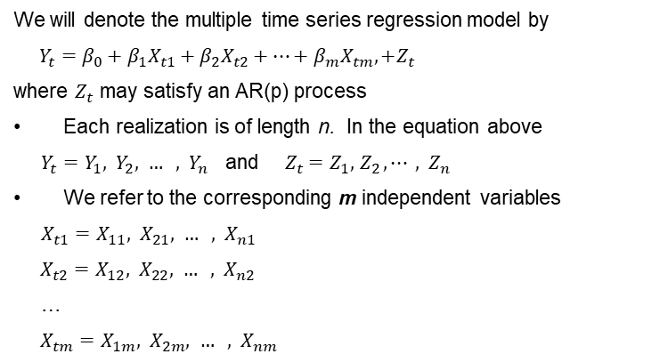
A brief reflection of thoughts and key takeaways – Week 12
multivariate approach - use more than one time-series variable to better understand data, make decisions (forecasts, etc.)
Multiple Regression with Correlated Errors
Question Concept Check 12.5.3-5
I do not see where to get the information needed for these answers. I even went line by line through the Sun Spot examples and was unable to see how it applied to the business data. Would you please go over this?
We will denote the multiple time series regression model by
${Y_{t}=β_{0}+β_{1}X}_{t1}+{β_{2}X}_{t2}+⋯+{β_{m}X}_{tm},+Z_{t}$
where $Z_{t}$ may satisfy an AR(p) process
Each realization is of length n. In the equation above
$Y_{t}=Y_{1}, { Y}_{2}, … , { Y}_{n}$ and ${{ Z}_{t} =Z}_{1}, { Z}_{2}, ⋯ , { Z}_{n}$
We refer to the corresponding m independent variables
${X_{t1}=X}_{11}, { X}_{21}, … , { X}_{n1}$
${X_{t2}=X}_{12}, { X}_{22}, … , { X}_{n2}$
…
${X_{tm}=X}_{1m}, { X}_{2m}, … , { X}_{nm}$
The first subscript is time (1, 2, … , n)
The second subscript indicates which variable it is

